Slide 1
R PROJECT ON TIME SERIES FORECASTING USING ARIMA MODEL

Slide 2
What are we Doing?
In this project we firstly analyze 26 years of data about the consumption of gas in UK and then based on that analysis, we try to forecast the next 10 year consumption and then validate it.

Slide 3

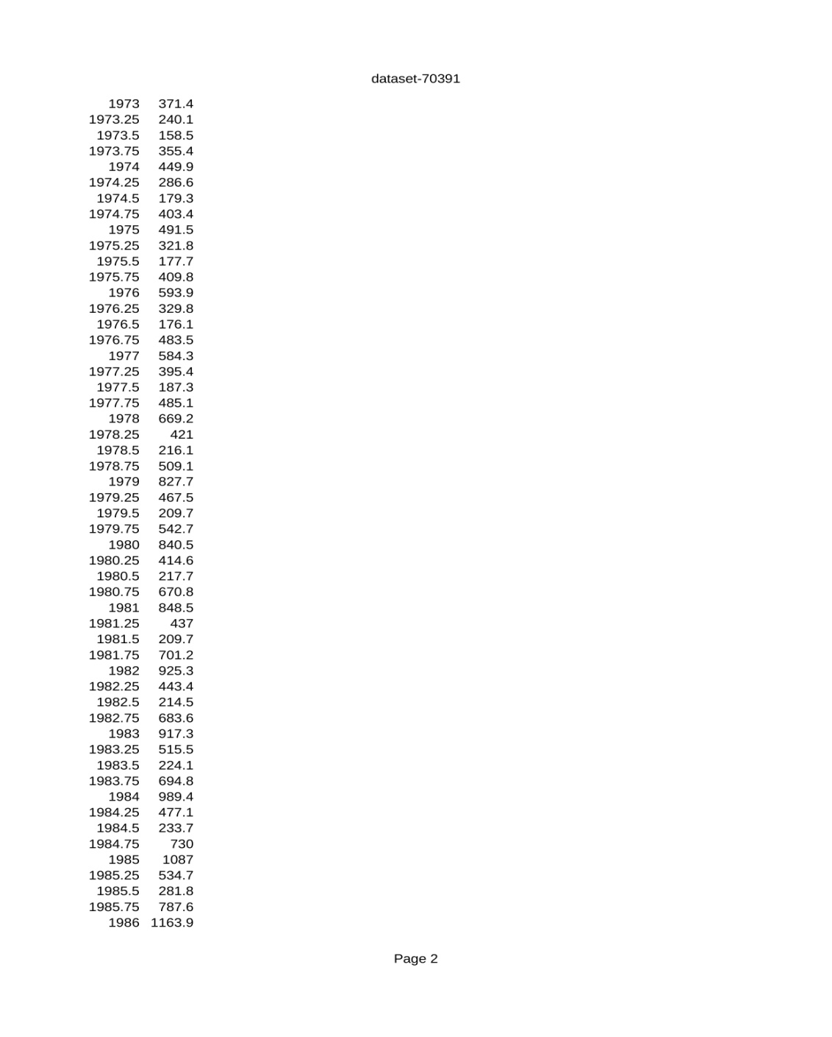
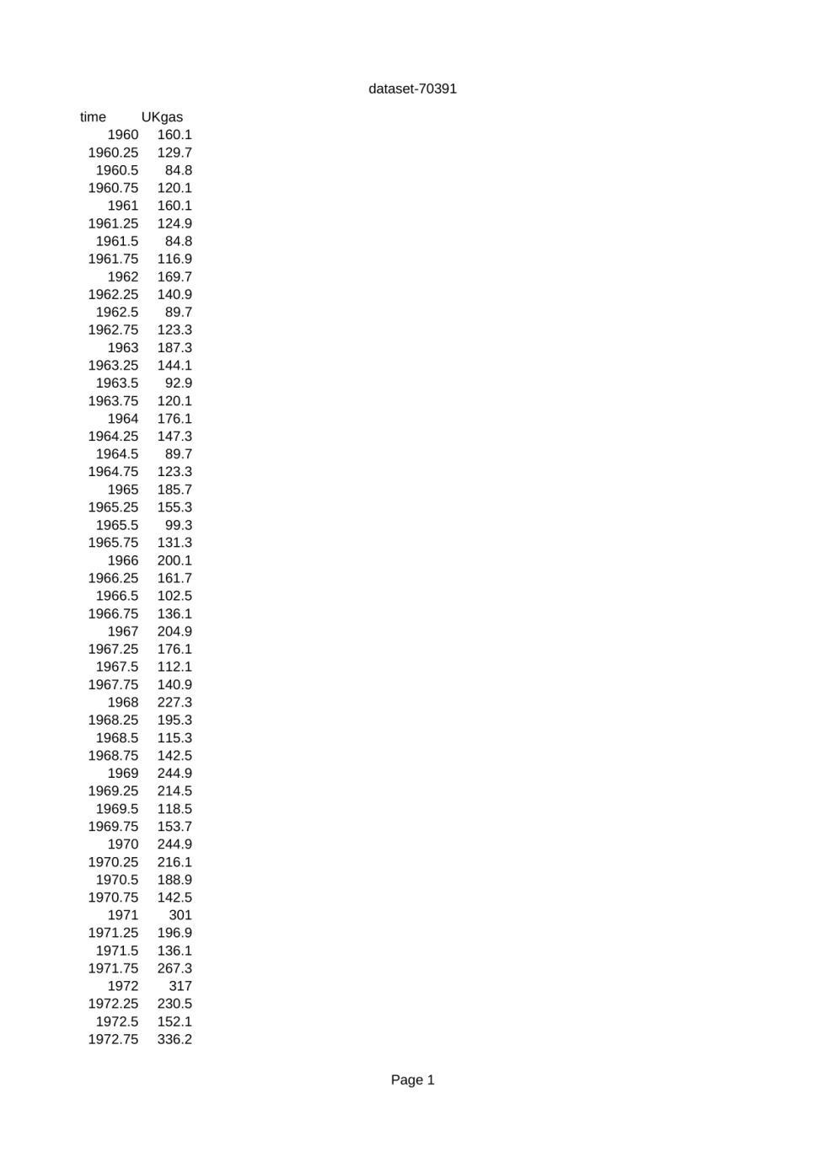
Ukgas Dataset

Slide 4
What is ARIMA? ARIMA, which stands for AutoRegressive Integrated Moving Average, is a popular statistical analysis model used for time series forecasting. The ARIMA model is used to understand and predict future points in a time series by accounting for various aspects of the series' past values. Here’s a breakdown of its components: AutoRegressive (AR) part: This part of the model involves regressing the variable on its own lagged (past) values. The number of lagged values included is denoted by "p" (the order of the AR part). Integrated (I) part: This part involves differencing the raw observations to make the time series stationary, which means that the mean and variance are constant over time. The number of differences needed to achieve stationarity is denoted by "d" (the order of differencing). Moving Average (MA) part: This part involves modeling the error term as a linear combination of error terms occurring at various times in the past. The number of lagged forecast errors in the prediction equation is denoted by "q" (the order of the MA part).

Slide 5
Components of ARIMA
This project is based on ARIMA forecasting.
ARIMA stands for AutoRegressive Integrated Moving Average, which is a widely used statistical method for time series forecasting. It combines three components:
1.Autoregressive (AR): This part of the model explains the value at time 𝑡,t using a linear combination of previous values. It is specified by the parameter 𝑝,p, which denotes the number of lagged observations included in the model.
2.Integrated (I): This component involves differencing the time series data to #make it stationary, which means removing trends and seasonality. It is specified by the parameter 𝑑,d, which denotes the number of differencing steps required.
3.Moving Average (MA): This part of the model uses past forecast errors in a #regression-like model. It is specified by the parameter 𝑞,q, which denotes the number of lagged forecast errors included in the model.

Slide 6
Underlying Assumptions
Following are the assumptions arima model makes before being applicable:
1. Stationarity: A time series is stationary if its statistical properties, such as mean, variance, and autocorrelation, are constant over time.
#Assumption: The ARIMA model assumes that the time series is stationary. This means that the data should not show trends or seasonal patterns.
2.No Autocorrelation in Residuals: Residuals are the differences between observed and predicted values.
#Assumption: The residuals from the model should be uncorrelated (i.e., no patterns in the residuals). This implies that the model has captured all the underlying structure in the data.
3.Sufficient Sample Size: The number of observations in the time series data.
#Assumption: ARIMA models require a sufficient number of observations to produce reliable estimates.

Slide 7
Steps in Forecasting
Following are the steps included in our forecasting
1. Gathering the data
2. Data visualization
3. Smoothing out the data
4. Stationarity and differencing
5. Fitting the model
6. Validation
7. Cross checking with auto arima

Slide 8

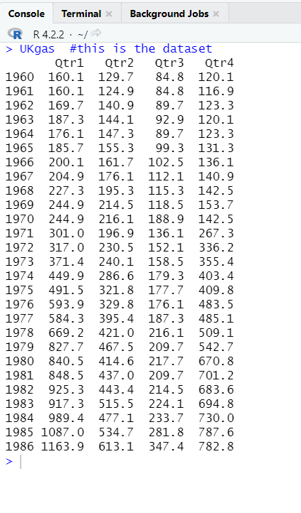
Step1:Gathering and viewing the data

Slide 9

Step 2:Data Visualization

Slide 10
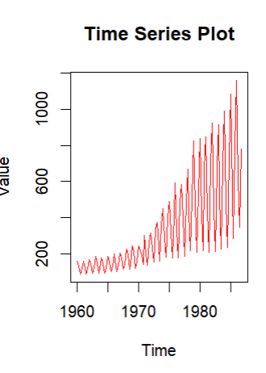

Slide 11
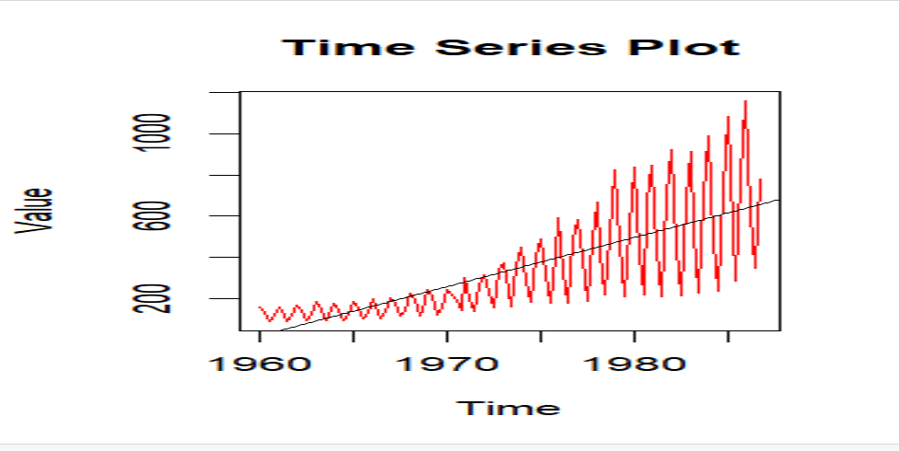

Slide 12
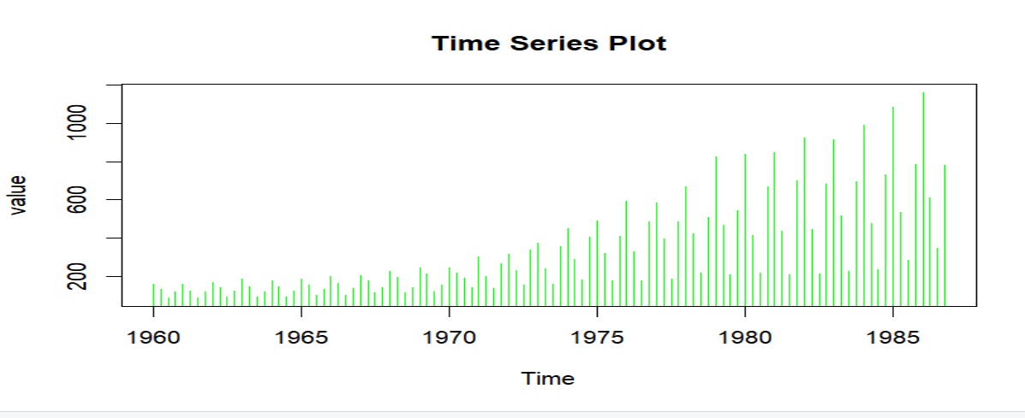

Slide 13
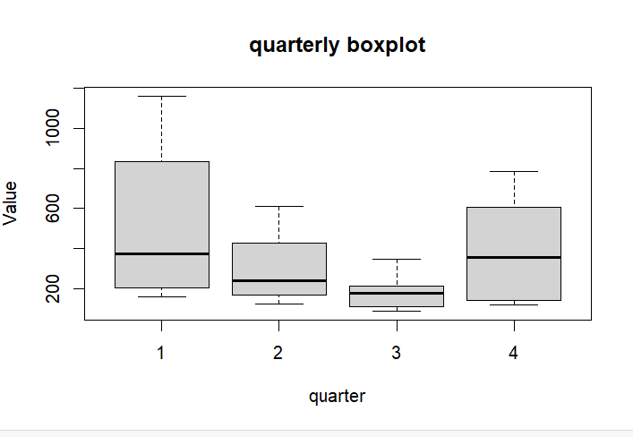

Slide 14

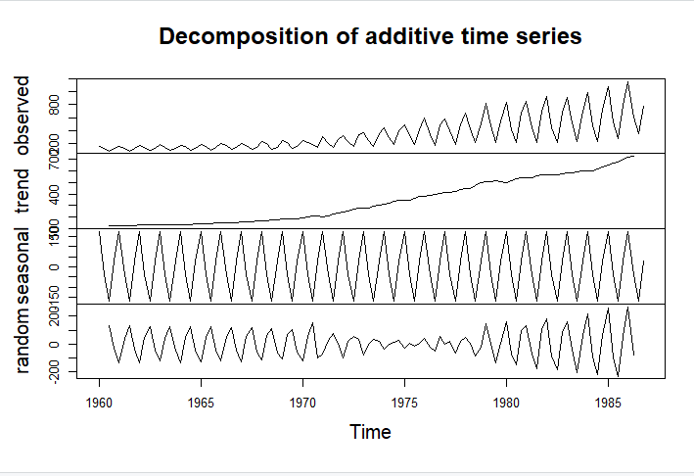

Slide 15
STEP 3:Smoothing out the Data
Now smoothing out is necessary as it helps in
1. Noise reduction: Noise is random variations without any underlying patterns.
2. Trend identification: The trend becomes more apparent by smoothening.
3. Forecasting : Forecasting becomes easier.
4. Data preparation : Smoothed data is a better input for ML algorithms.

Slide 16

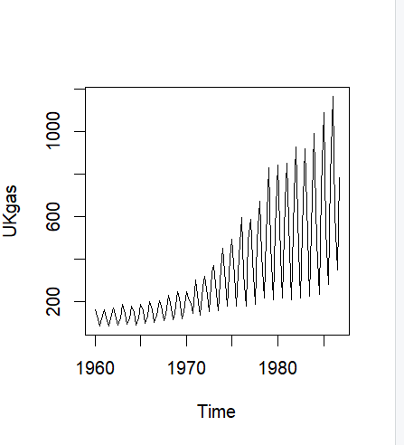

Slide 17
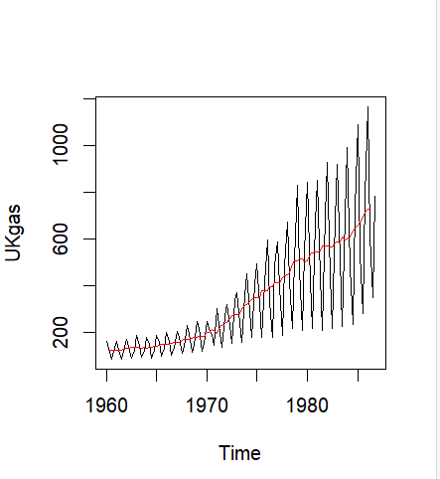

Slide 18
1.rollmean refers to the rolling mean (or moving average), a commonly used technique in time series analysis for smoothing data.
The rolling mean is calculated by averaging a fixed number of consecutive data points in the series, which helps to reduce noise and highlight underlying trends.
Here we're using 4 data points at once.

Slide 19
Step 4:Stationarity and Differencing
For applying arima modelling it is necessary that the data is stationary i.e.
the mean and variances are homogenized

Slide 20

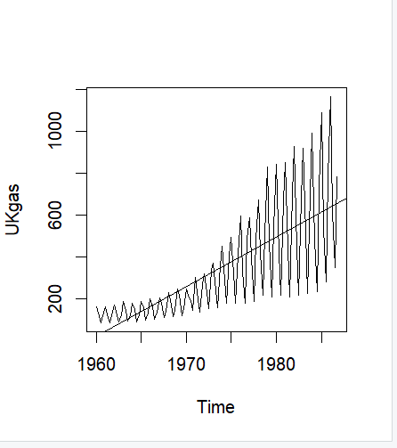
4.1 Homogenizing the variance

Slide 21
Here,in the above plot we can see that the variance (the distance between the spark line and regression line) is constantly changing so we take the log values so as to minimize the variance

Slide 22

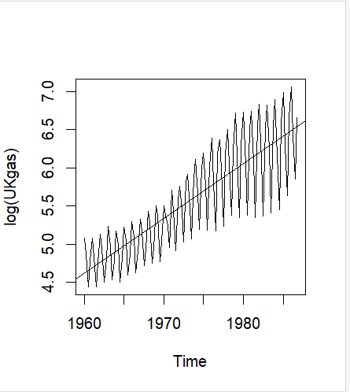

Slide 23
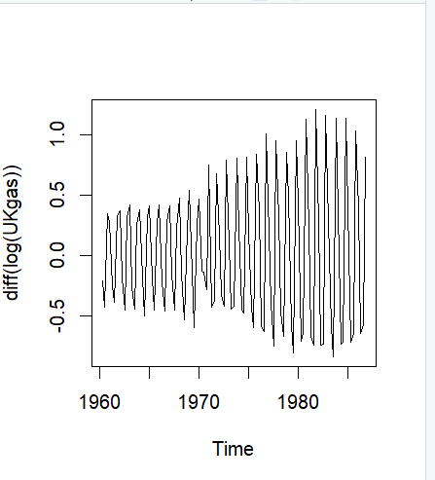
4.2 Homogenizing the mean

Slide 24
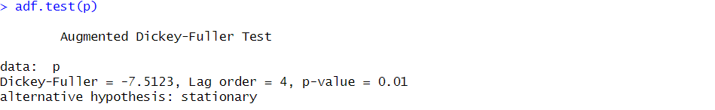

#this is a stationarity test and it shows that p value is smaller than printed value indicating that we reject the null hypothesis of the data being non stationary. Hence we can say that the data is stationary.

Slide 25
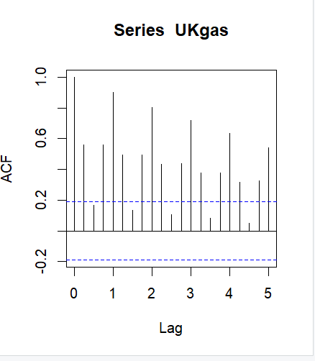
Here we will use ARIMA manually and then compare our findings with auto ARIMA ones.library(tseries)

Slide 26
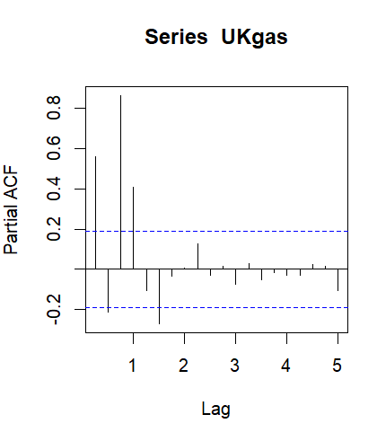

Slide 27
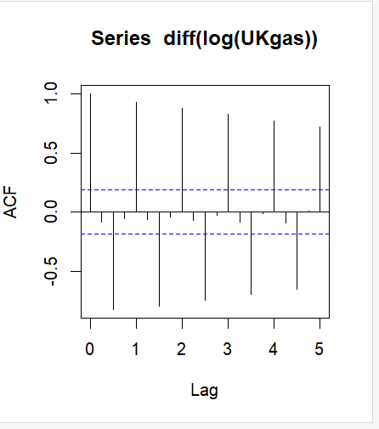
#acf-auto correlation factor
#this determines the value of q
#q=0

Slide 28
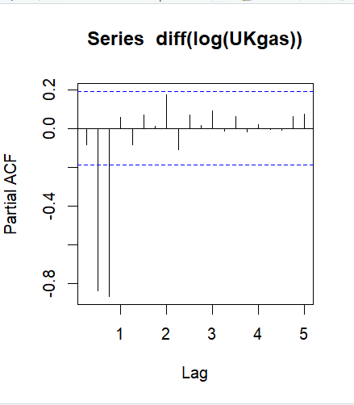
#pacf-partial auto correlation factor
#this determines the value of p
#p=0,d=1,d is the number of times we have to differentiate so as to homogenize the mean
# arima(0,1,0) is the best fit
#c(pdq)=c(0,1,0)

Slide 29
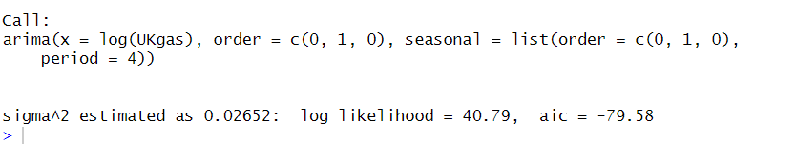
Step 5:Fitting the ARIMA Model

Slide 30
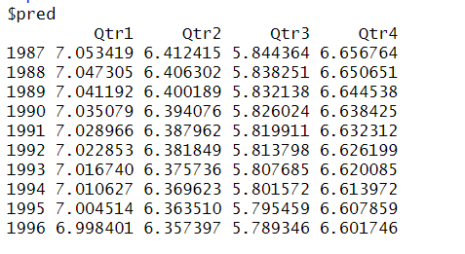

Slide 31
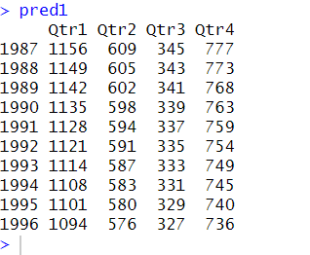
#since the predicted data is actually the logarithmic value of the actual data
#hence this extra step
#here we've got the predicted values for the next 10 years

Slide 32
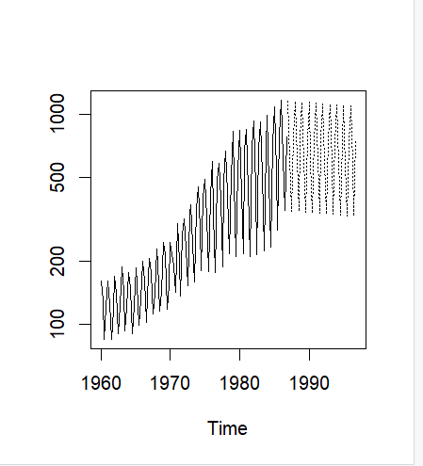
#using tsplot function to plot both the available data and future data.

Slide 33

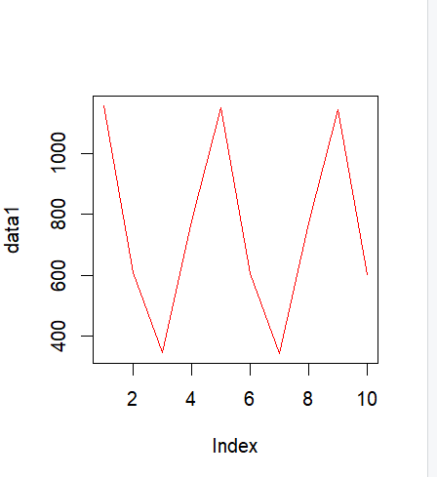

Slide 34
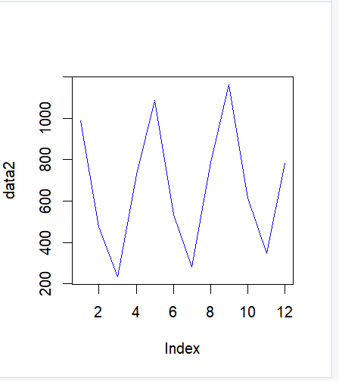

Slide 35
#data 1 is the first 10 values of predicted data and data 2 is the last 12 values of the available data.
#plotting them shows us the consistency of the prediction of the data.

Slide 36
R-projects/project__.R at main · Mohit-exe/R-projects (github.com)
This is the link to the source code of this project.

Slide 37
Validating with Auto Arima
the steps are same , only the method changes.

Slide 38
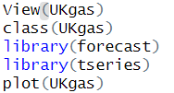
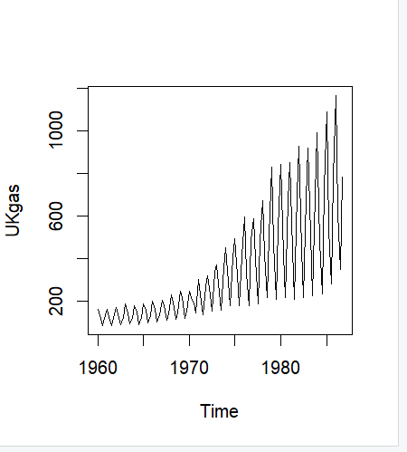

Slide 39
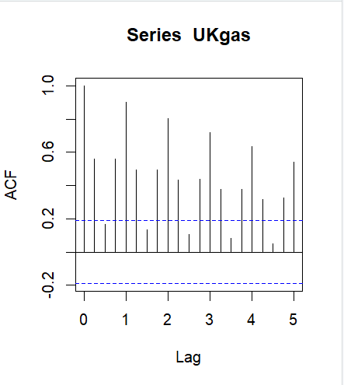

Slide 40
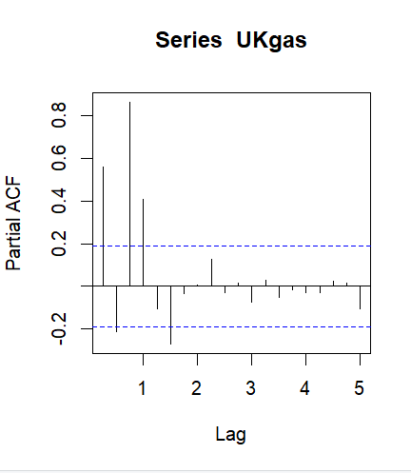

Slide 41
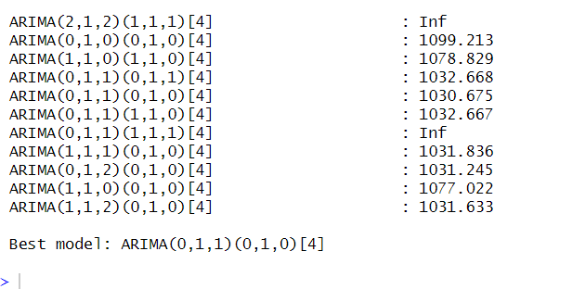

Slide 42
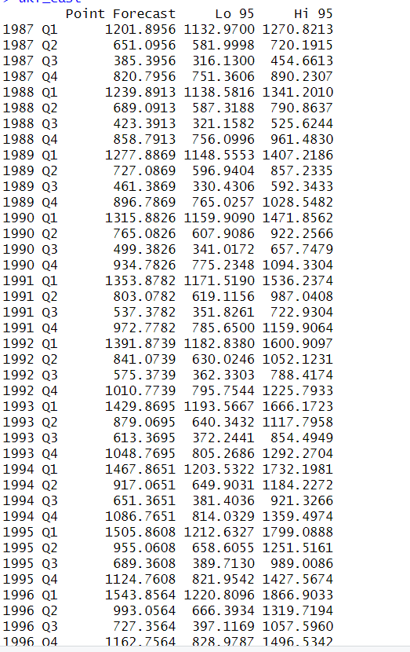

Slide 43
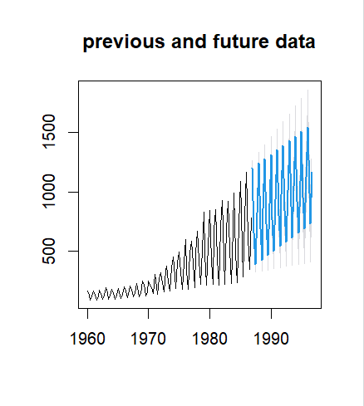

Slide 44
Box Ljung Test
The Box-Ljung test is a statistical test used to check the randomness of residuals (errors) from a time series model. It helps to determine whether there is any significant autocorrelation remaining in the residuals.
Purpose of the Box-Ljung Test
Model Adequacy: The primary purpose is to test whether a given time series model has adequately captured the underlying process. If the model is good, the residuals should behave like white noise (i.e., they should be uncorrelated).
Detection of Remaining Structure: If the test indicates significant autocorrelation in the residuals, it suggests that there is remaining structure in the data that the model has not accounted for, implying that the model may need further refinement or a different model might be more appropriate.

Slide 45
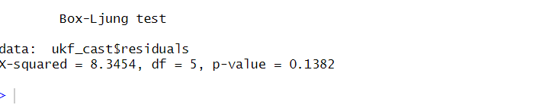
#in first iteration it gives p value greater than 0.05 which means there is no significant auto correlation among the residuals
#iterate it by taking different lags
#taking lag=10

Slide 46
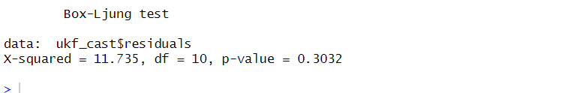
#still greater than 0.05
#we can check it by taking more different lag values and check that the data values have no significant correlation among them

